Slide 1
Data Science and Machine Learning
Antony Ross

Slide 2
Environment Set-up
Install Anaconda 3.x
Create a course folder
Launch Anaconda Navigator

Slide 3
The Data Science Process
Identify the question
Get the data
Clean the data
Explore the data
Model the data
Communicate the results

Slide 4
The Data Science Process
Identify the question
Get the data
Clean the data
Explore the data
Model the data
Communicate the results

Slide 5
Identify the question

Slide 6
Identify the question
Answerable
Actionable
Narrow
Specific

Slide 7
Get the data

Slide 8
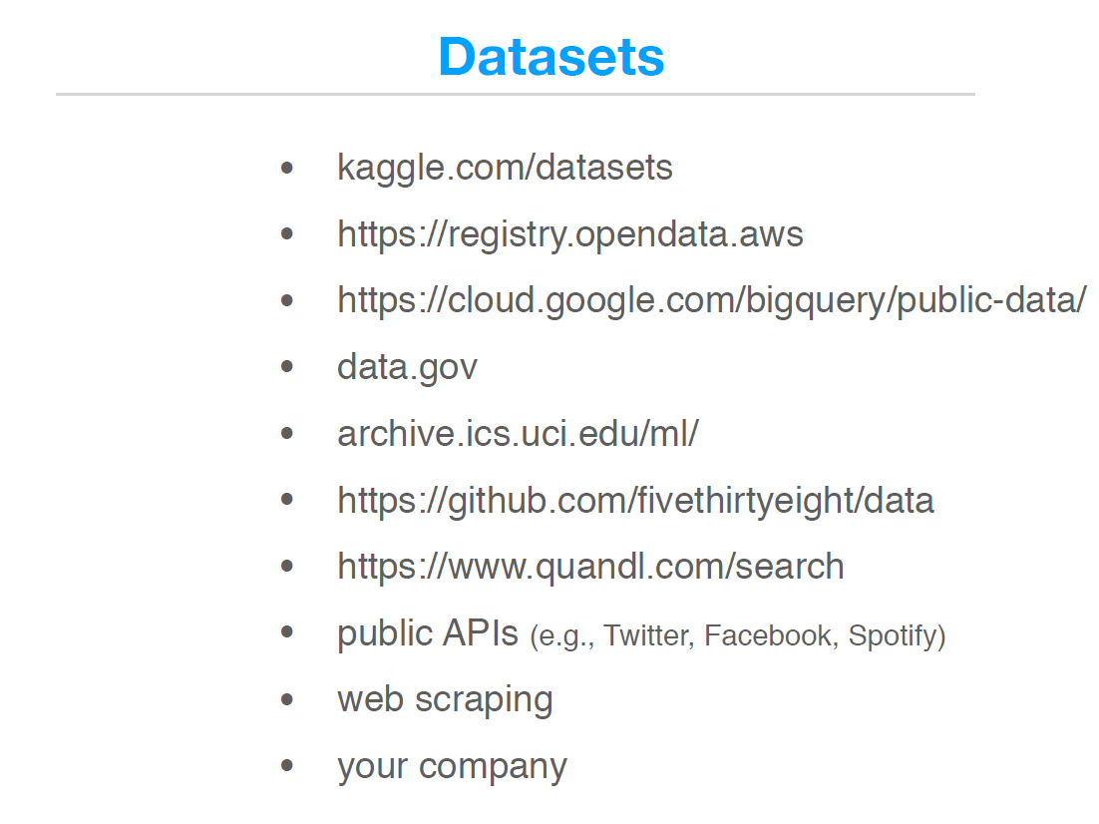
Data Sources

Slide 9
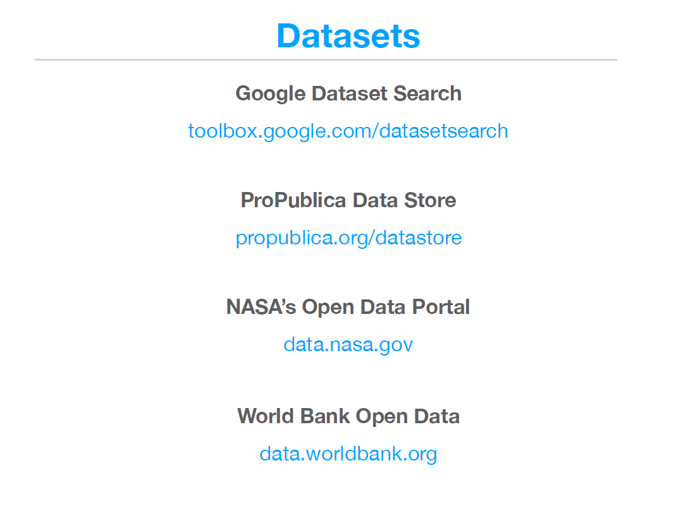
Data Sources

Slide 10
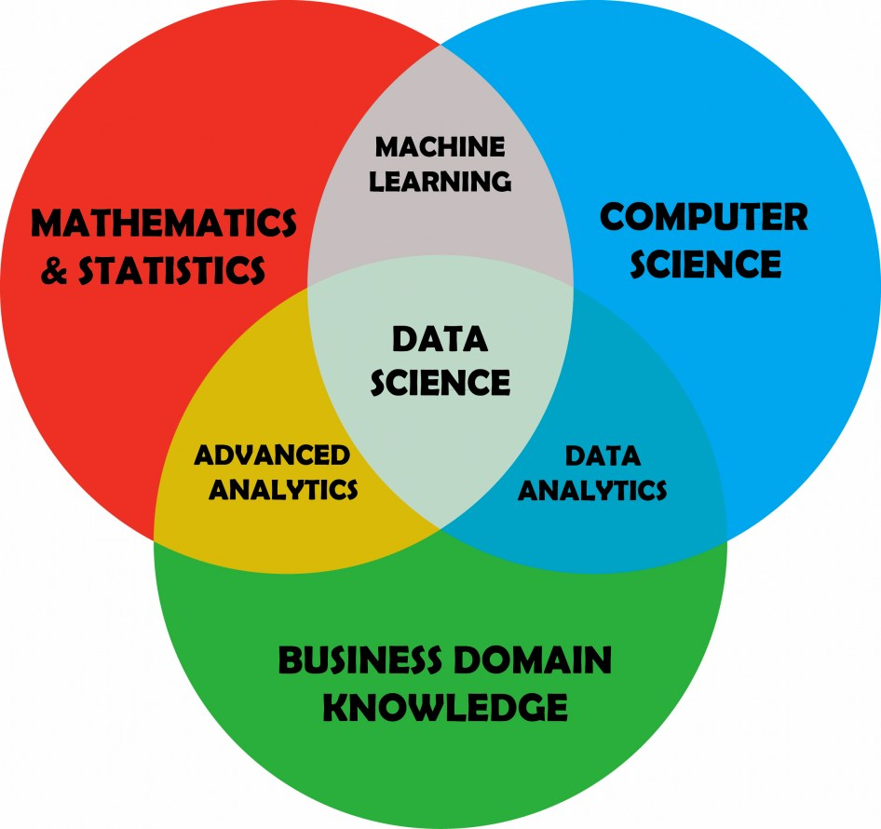
Data Science

Slide 11
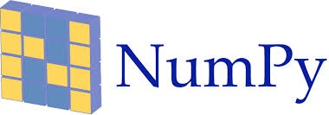
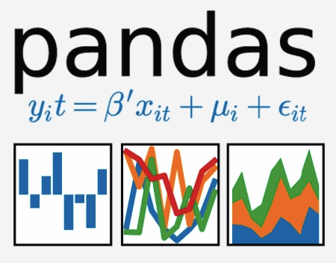



Python Libraries for Data Analysis
NumPy
Pandas
Matplotlib
SciPy
-learn

